Slide 1

What is Self-Regulation?
Self-regulation is the ability to understand and manage your behaviour and your reactions to feelings and things happening around you.

Slide 2




Why is Self-Regulation Important?
Research has shown that children with strong emotional regulation skills are better able to :
focus their attention
remember and understand complex information
navigate challenges with greater resilience
maintain positive relationships with others

Slide 3
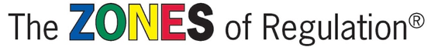
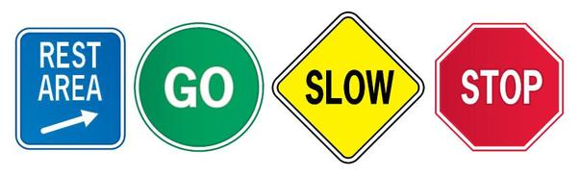
https://www.youtube.com/watch?v=zZ9X-d3oZvQ

Slide 4
What are the zones?
The Zones of Regulation will help you self-regulate your feelings.
It helps you to categorise how your body feels and explain your emotions. The four coloured zones help you to do this.
The Zones of Regulation provides you with tools to become more aware and independent in controlling your emotions and impulses.

Slide 5

The Zones of Regulation teaches us to categorise our emotions into
four main Zones.
Blue Zone: sad, sick, tired or bored (low state of alertness – brain and/or body is moving slowly or sluggishly).
Green Zone: in control, calm, happy and ready to learn (regulated state of alertness).
Yellow Zone: worried, frustrated, silly, excited, scared or overwhelmed (heightened state of alertness but you still have some control).
Red Zone: elated, angry, wild, terrified (heightened state of alertness and out of control).

Slide 6
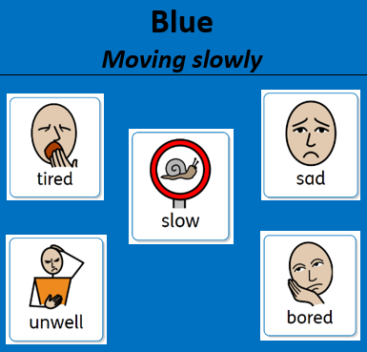
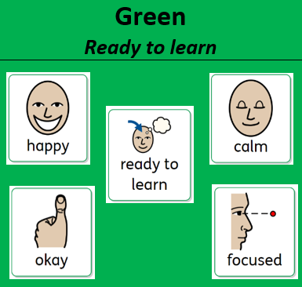
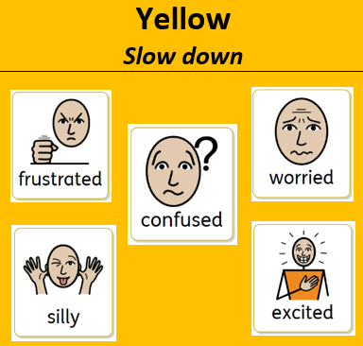
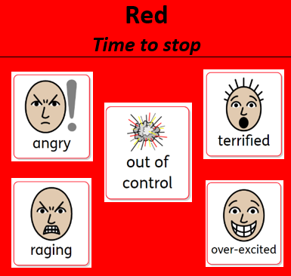
Which Zone are you in?
Using the Zones of Regulation allows the children opportunity to reflect on how they are feeling, why they are feeling that way and to self-regulate their feelings.

Slide 7
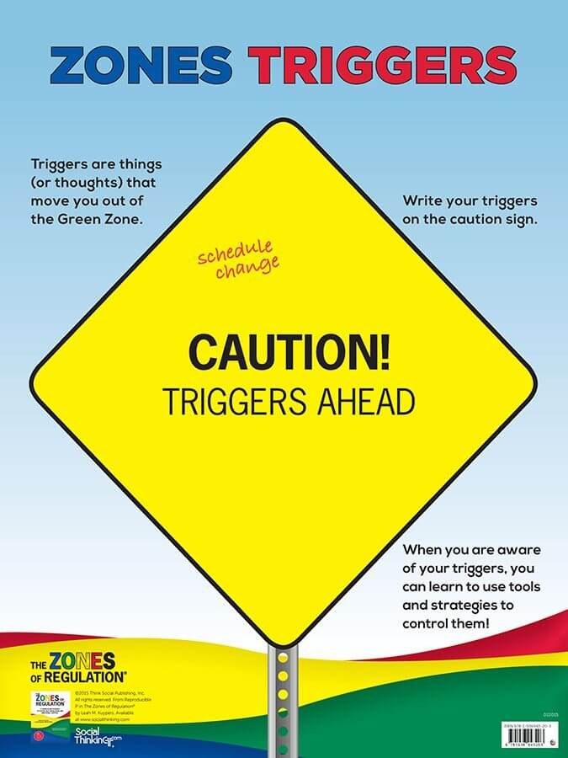
What triggers the zones?
An emotional trigger is a response to a person, situation, event, conversation etc., that provokes a strong emotional reaction in you.
Often we are not self aware when we are triggered and fall into reacting quickly, so the zones help us to think about any triggers that provoke a strong emotional response from us.
I wonder what your triggers are? What might put you in the blue zone? How about the yellow zone? And the red zone?

Slide 8
Key Points
There is no ‘bad’ zone - the aim is to teach the children that no emotion is bad, as long as it is expressed in an appropriate way.
Everyone experiences all of the Zones at different times and in different circumstances.
We can’t change the way children feel BUT we can help them manage their feelings and behaviours. “It’s OK to be angry but it is not OK to hit…” “It’s okay to feel frustrated when challenged but that doesn’t mean we give up…” “What tool(s) can you use to help you manage how you are feeling?”

Slide 9
The Zones Toolkit
The Zones of Regulation teaches us how to identify and use tools to manage our feelings.
Blue Zone tools: help wake up our bodies, feel better and regain focus.
Green Zone tools: help us stay calm, focused and feeling good. These are often proactive strategies.
Yellow Zone tools: help us regain control and calm ourselves.
Red Zone tools: help us stay safe and start to calm down.
This might include sensory tools, calming techniques and thinking strategies.

Slide 10
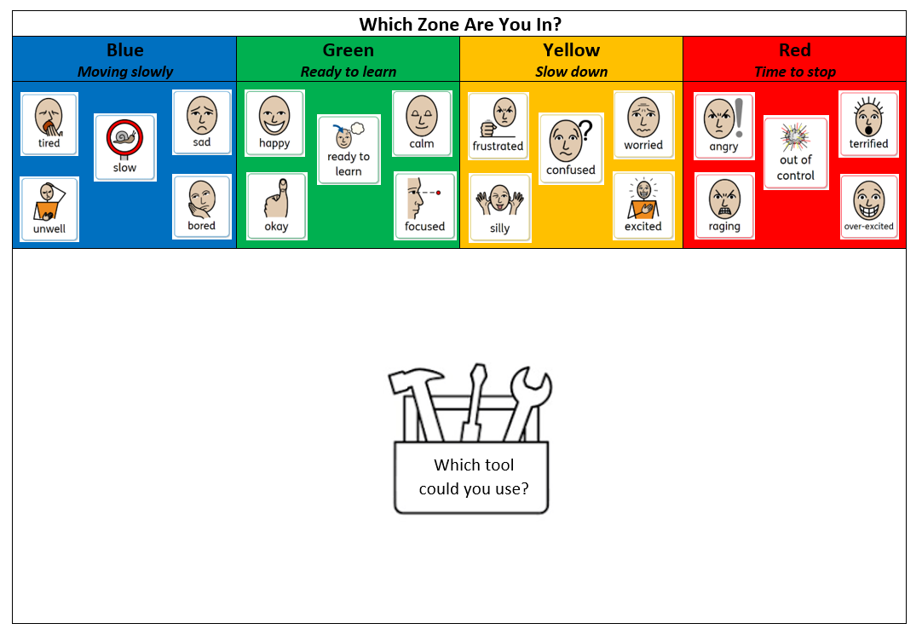

Slide 11


