Slide 1
The National Nurturing Schools Award
Recognition for everything we do to make our school such a nurturing place!

Slide 2


The Six Principles of Nurture
Definitions:
Principles: a set of rules which inform behaviour and actions.
Nurture: to care for and encourage the growth and development of others.

Slide 3
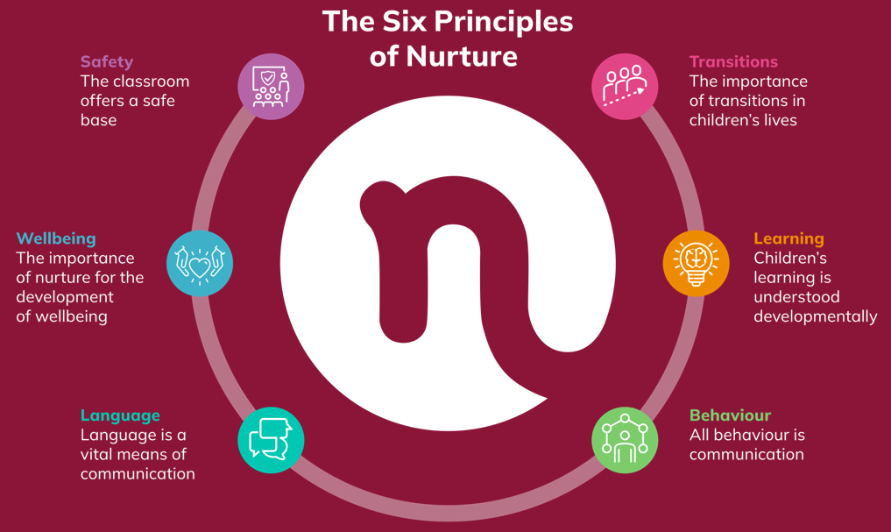

Slide 4


Principle 1: Learning
Children’s learning is understood developmentally
Child Friendly: My learning is personalised to me
We recognise that all children are at different stages of development – socially, emotionally, physically and intellectually – and need to be responded to at their developmental level in each of these areas. Our curriculum focuses on teaching the children at their own developmental levels, stage not age, and providing them with the skills, knowledge and resources required to become confident learners.

Slide 5


Principle 2: Safety
The classroom offers a safe base
Child Friendly: Our school is a safe place to be
We want our school to feel a safe place for all. A place where the children feel happy, valued and secure so that they can explore, learn and grow with confidence. This doesn't just refer to the physical environment but also emotional security and well-being. This principle is underpinned by our school values and 'Positive Relationships and Behaviour for Learning' policy, which highlights the importance of nurture through positive relationships and positive environments that are conducive to learning. This also places an emphasis on adults being reliable and routines being consistent throughout the school which, in turn, offers a sense of security for all children.

Slide 6

Principle 3: Wellbeing
The importance of nurture for the development of wellbeing
Child Friendly: My wellbeing matters
We care about all members of our school community and place wellbeing at the heart of everything we do. We know that nurturing relationships are key to emotional wellbeing and prioritise creating positive connections between children, staff and parents to promote a sense of belonging and happiness. We listen and respond to individual needs and recognise the importance of everyone feeling valued. In order to achieve this, we ensure sufficient time is given to notice and celebrate achievements, and to give support where it is needed.

Slide 7

Principle 4: Language
Language is a vital means of communication.
Child Friendly: My voice is valued
We know that effective communication is essential for learning and relationships, and so we place a big emphasis on the development of language skills to help children express themselves clearly and confidently. We also recognise the importance of ‘feeling heard’ in order to feel valued so we regularly seek feedback from those within our school community.

Slide 8


Principle 5: Behaviour
All behaviour is communication
Child Friendly: My behaviour shows how I am feeling
Our 'Positive Relationships and Behaviour for Learning' policy recognises that people communicate their feelings through their behaviour. We understand that it is the adult’s role to help children to understand their feelings, express their needs appropriately, and use non-threatening and supportive language to resolve situations. Our first responsibility in dealing with difficult or challenging behaviour, after safety, is to try to understand what the child is trying to tell us. We use the Zones of Regulation to support the children to reflect on their behaviour, and understand how to express their emotions appropriately.

Slide 9


Principle 6: Transitions
The importance of transitions in children’s lives
Child Friendly: I can cope with changes in my life
We know that children experience many transitions throughout their lives, and on a daily basis. For example, transitions from home to school, from breaktime to lessons, or moving from nursery to primary to secondary school. We know that transitions can be challenging but we ensure we provide guidance and support to help children navigate these changes (no matter how big or small) smoothly.

